Slide 1

Rust for High-level Languages
Kyle Barron
Spatial Data Science across Languages
Or, Considering Rust
Notes:
- The goal of this talk is to describe Rust, why it matters, and why I've invested a lot of time in learning it. Some parts will be moderately technical, but ideally as approachable as possible, feel free to ask questions.
- No code in this talk!
- This will focus on motivations for Rust

Slide 2
What is Rust?
Notes:
We'll come back to more features about Rust, but first, I want to go into the decision process that led me to decide to learn Rust.
That’s just about all I knew about Rust when I decided it was worth trying out.

Slide 3
“A language empowering everyone to build reliable and efficient software.”
– Rust website
Notes:
Uhh, that's kinda gibberish. Couldn't you say that about any language?

Slide 4
The high level
What is Rust?
Compiled language:
Harder/slower to write than Python, R, or JS
Compiles to machine code & no runtime:
Just as fast as C/C++
Helpful compiler:
Prevents accidentally shooting yourself in the foot
Fine-grained control over memory usage
Requires more thought over how program runs
Can be used to build libraries for another language
Python, JavaScript (through WebAssembly), R, Go, C, C++
“Like C++ but better”
Me

Slide 5
Why did I decide to learn Rust?
Notes:
We'll come back to more features about Rust, but first, I want to go into the decision process that led me to decide to learn Rust.
That’s just about all I knew about Rust when I decided it was worth trying out.

Slide 6
Because I love Python and JavaScript
Notes:
We'll come back to more features about Rust, but first, I want to go into the decision process that led me to decide to learn Rust.
That’s just about all I knew about Rust when I decided it was worth trying out.

Slide 7
Because I love Python and JavaScript
(yes, really)
Notes:
We'll come back to more features about Rust, but first, I want to go into the decision process that led me to decide to learn Rust.
That’s just about all I knew about Rust when I decided it was worth trying out.

Slide 8
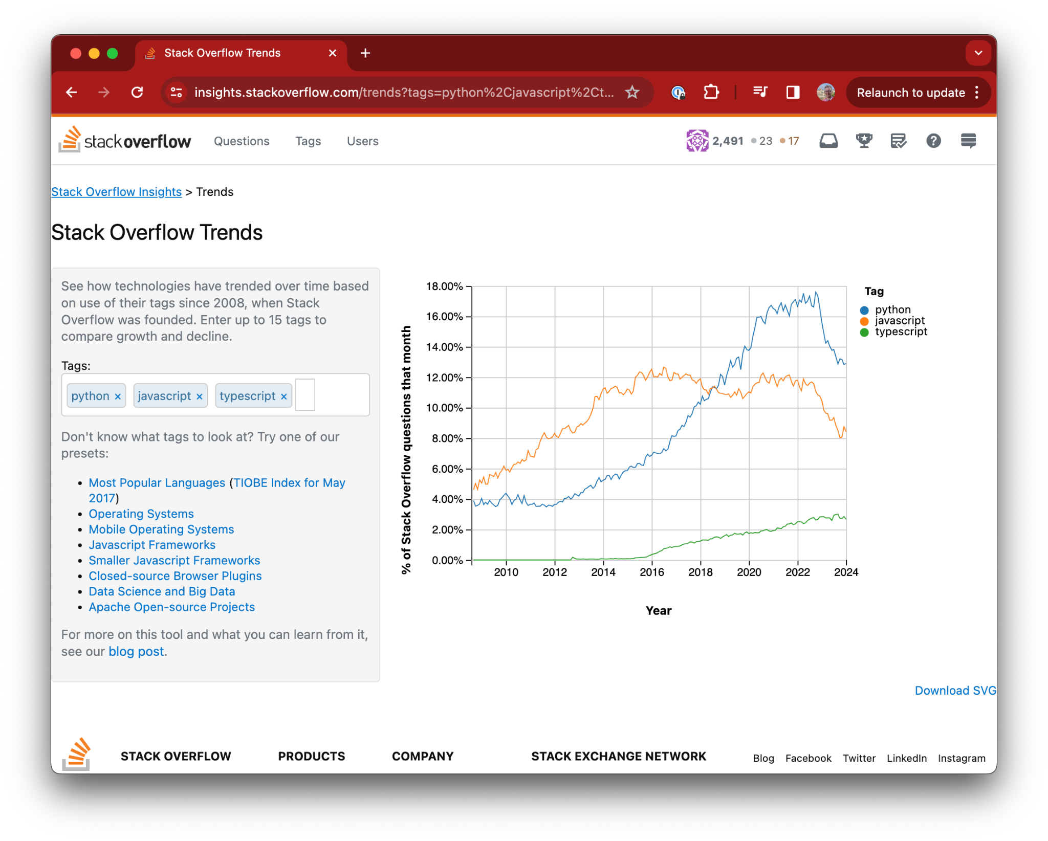
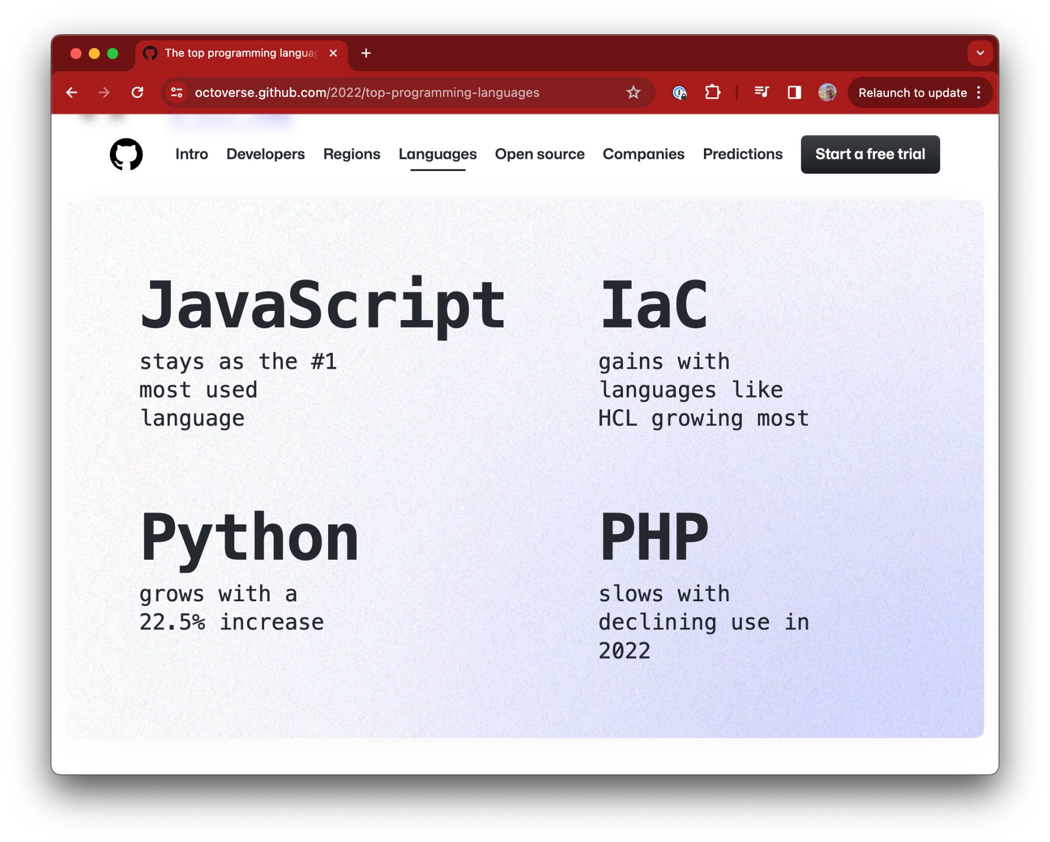
Python and the browser are accessible to the broadest audience
Accessibility matters

Slide 9

Python and the browser are accessible to the broadest audience
Accessibility matters

Slide 10
Python and the browser are accessible to the broadest audience
Python’s (& R’s) strength is as a glue language
Numerical processing in pure Python is slow
E.g. numpy: simple, easy to use API for C code
Relatively few people write low level code, a massive community benefits

Slide 11

Python and the browser are accessible to the broadest audience
Advent of WebAssembly
WebAssembly (abbreviated as Wasm):
Technology that allows running compiled code (e.g. C, C++, Rust) from JavaScript/the browser
JavaScript becoming glue language, like Python
Fewer applications will be JS-only

Slide 12
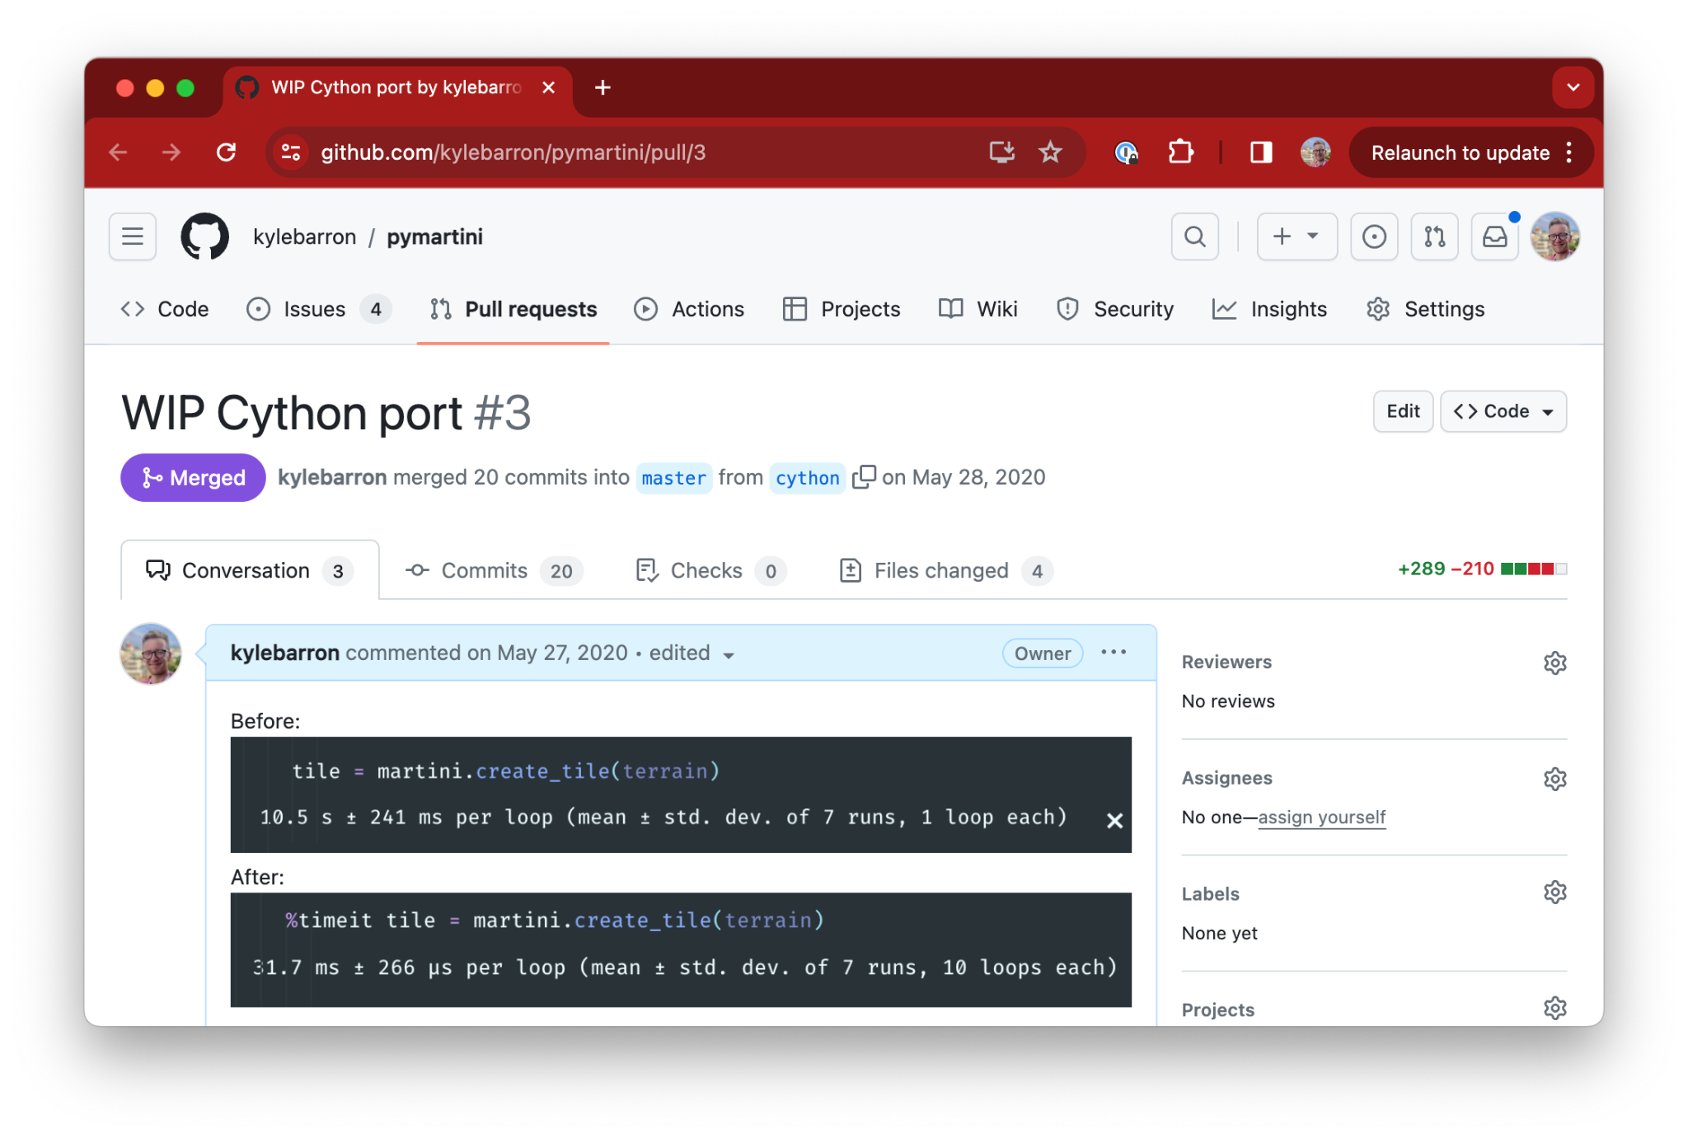
Python and the browser are accessible to the broadest audience
Python was my gateway drug
Started learning Python after college
Began with scripts to automate my job; gradually got interested in how things worked under the hood
numpy: 100x faster code with vectorized numpy
Small Cython project:
Add types to Python code, made it 330x faster

Slide 13
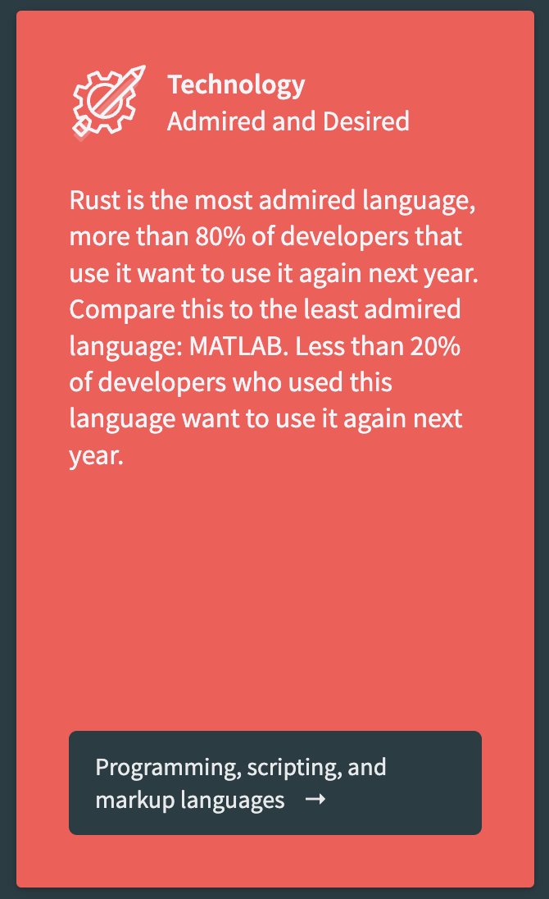
Python and the browser are accessible to the broadest audience
So I decided to learn Rust
Wager:
Python & the browser will keep growing
Opportunity in libraries binding to low-level languages
Options: C, C++, Cython, or Rust
“Most loved” language in Stackoverflow survey for 8 years in a row
Let’s try it!

Slide 14
What is Rust?
Notes:
We'll come back to more features about Rust, but first, I want to go into the decision process that led me to decide to learn Rust.
That’s just about all I knew about Rust when I decided it was worth trying out.

Slide 15
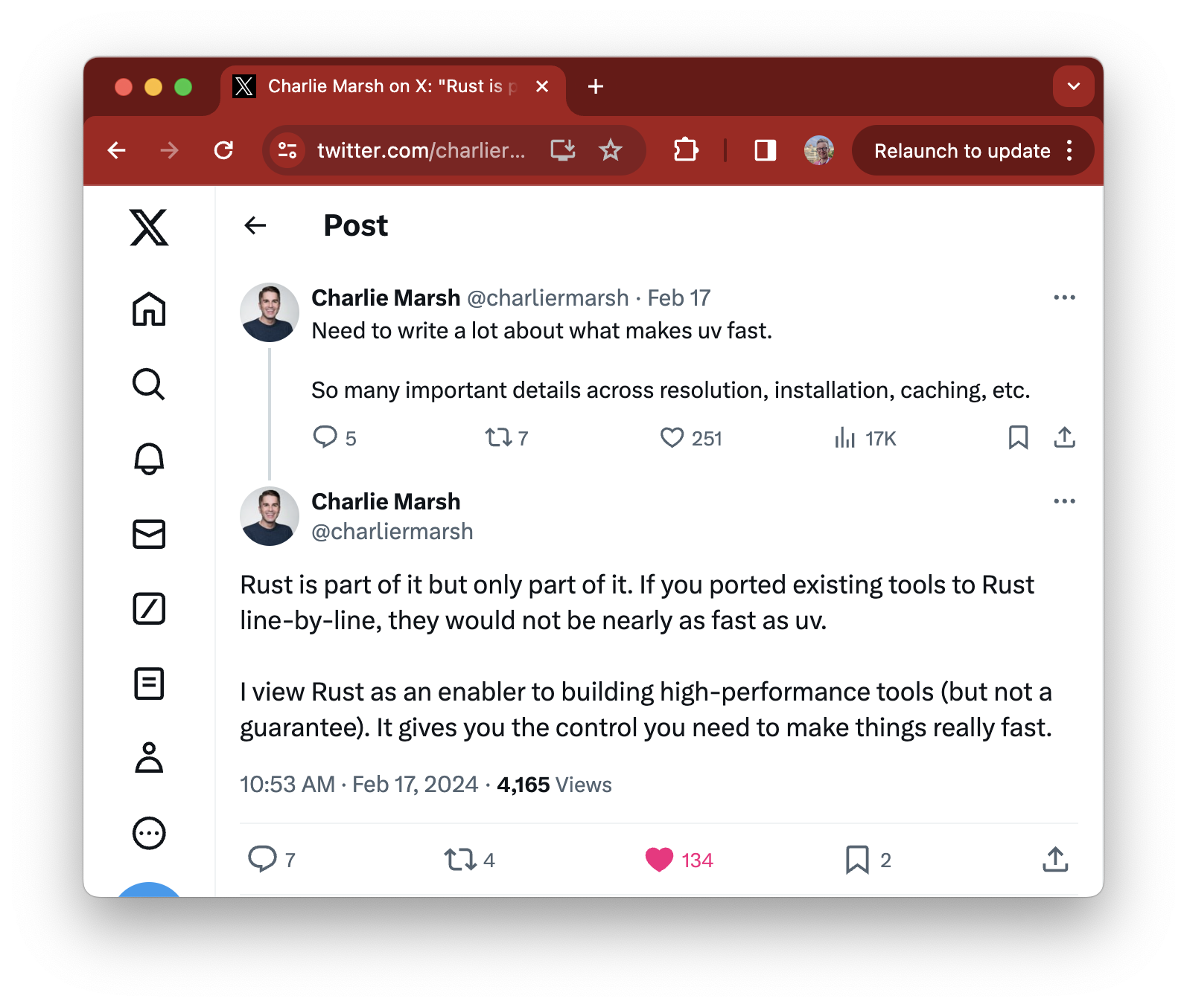
Python and the browser are accessible to the broadest audience
Fast & memory safe
Low-level control over data layout
Compiles to native code
Can be equally as fast as C, C++, etc
Author of Ruff and uv

Slide 16
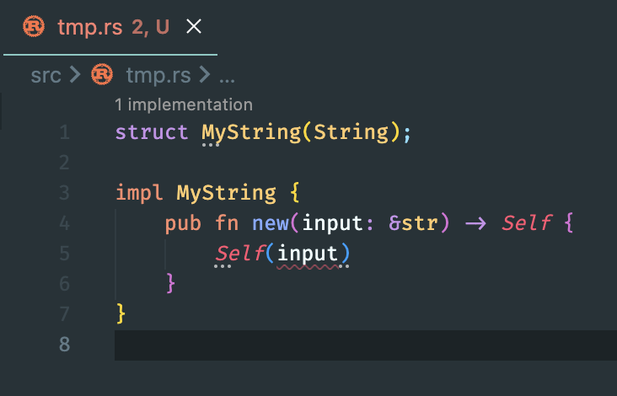
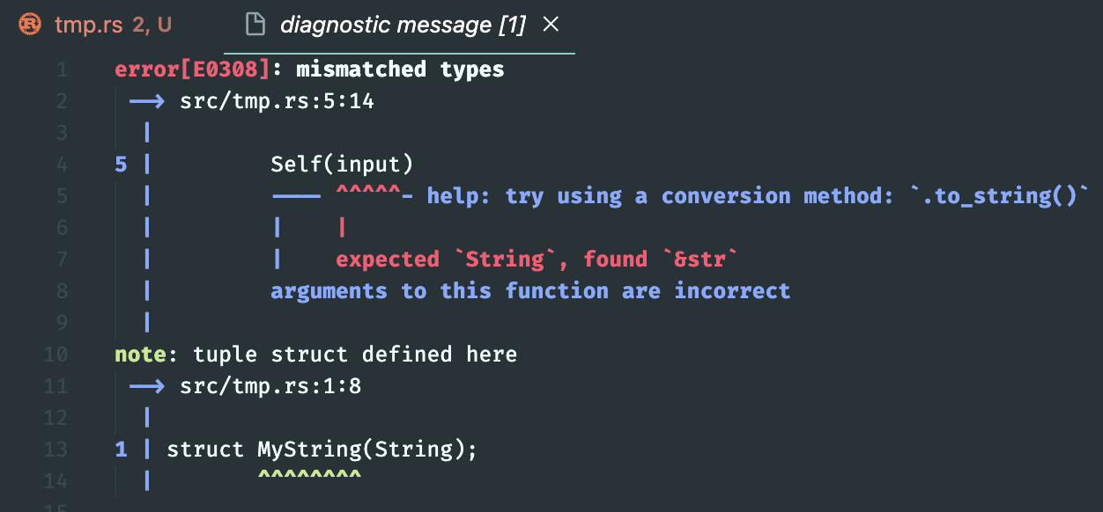
Python and the browser are accessible to the broadest audience
Strict compiler
Prevents shooting yourself in the foot
Rust compiler disallows classes of bugs
No segfaults (unrecoverable crashes)
No invalid memory access (more secure)
No data races when multithreading
Compiler teaches you
Type safety

Slide 17
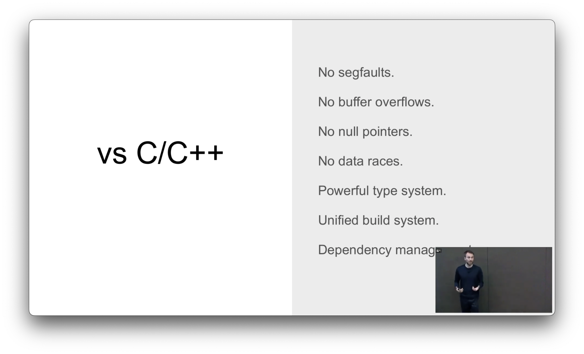
Python and the browser are accessible to the broadest audience
Comparison to C++
From “Considering Rust” https://www.youtube.com/watch?v=DnT-LUQgc7s

Slide 18
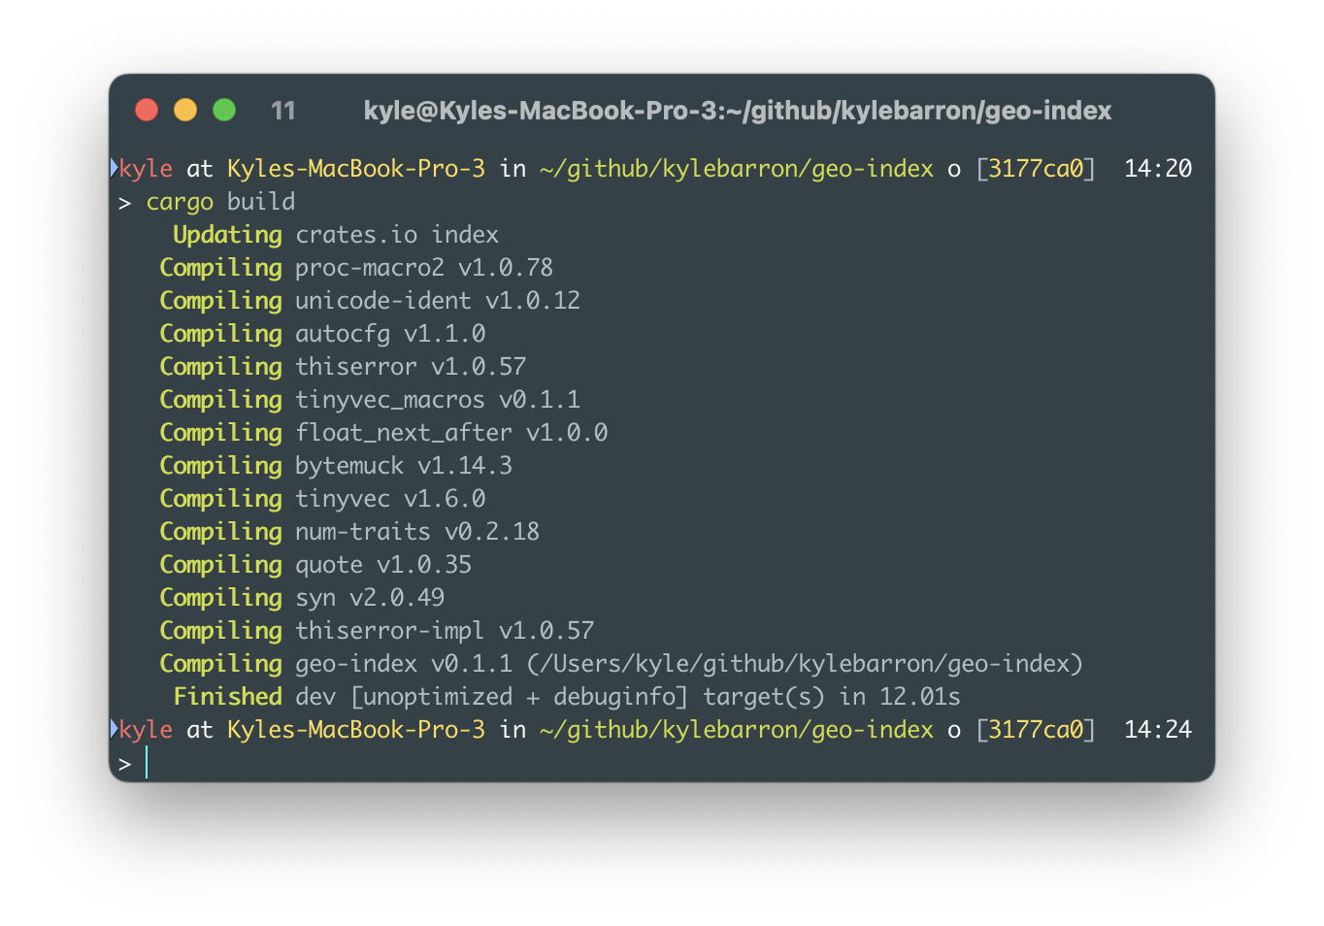
Python and the browser are accessible to the broadest audience
Incredible build tooling
No manual dependency handling
No search paths
Just works*
pure-Rust dependencies will always just build
Extra work possible for C dependencies

Slide 19
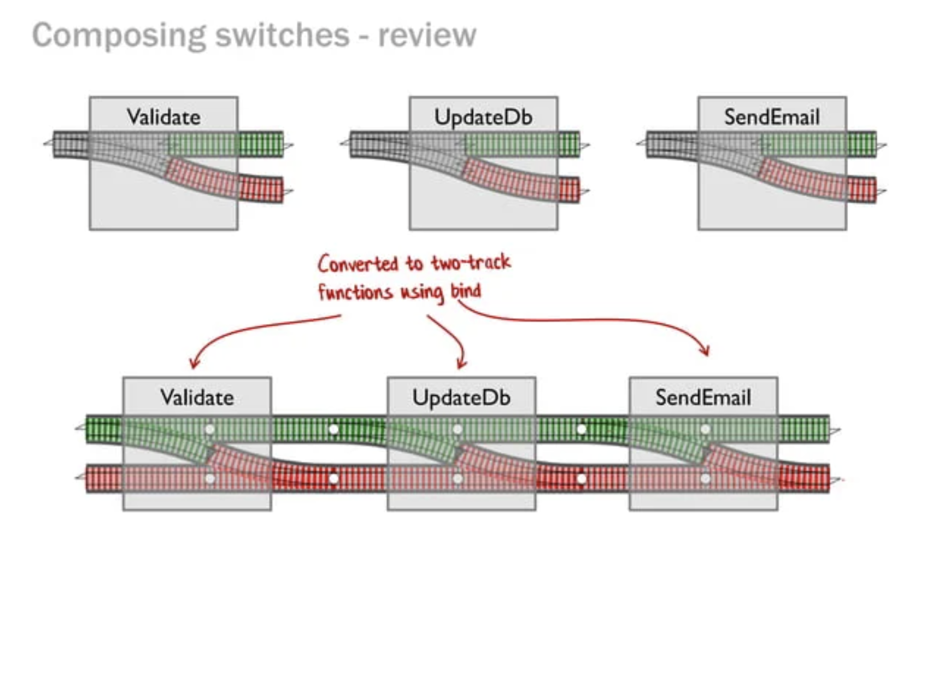
Python and the browser are accessible to the broadest audience
Really good error handling
“Accidental errors” are impossible
The output of any function must be checked for errors
In practice, less difficult/verbose than may sound
“Railway oriented programming”
https://fsharpforfunandprofit.com/rop/

Slide 20
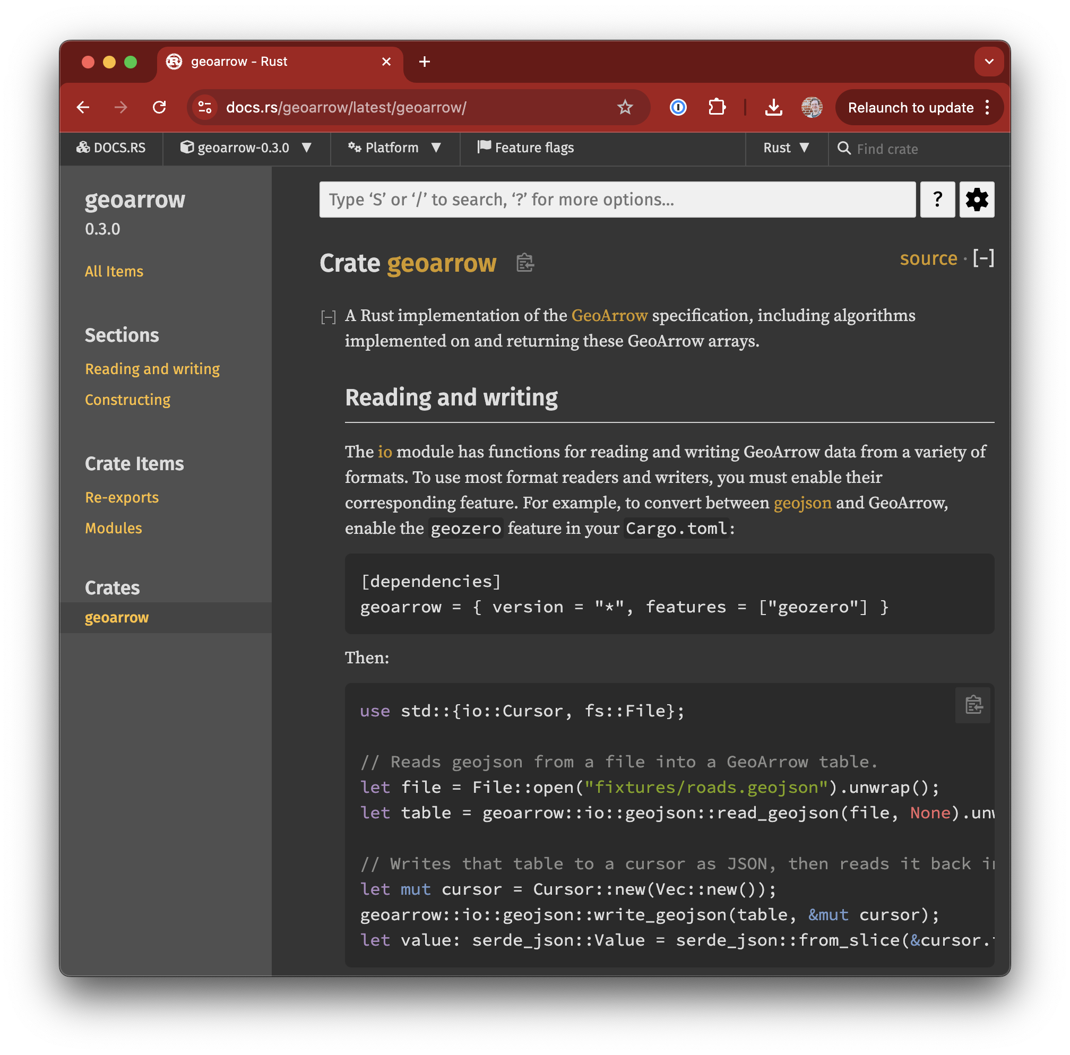
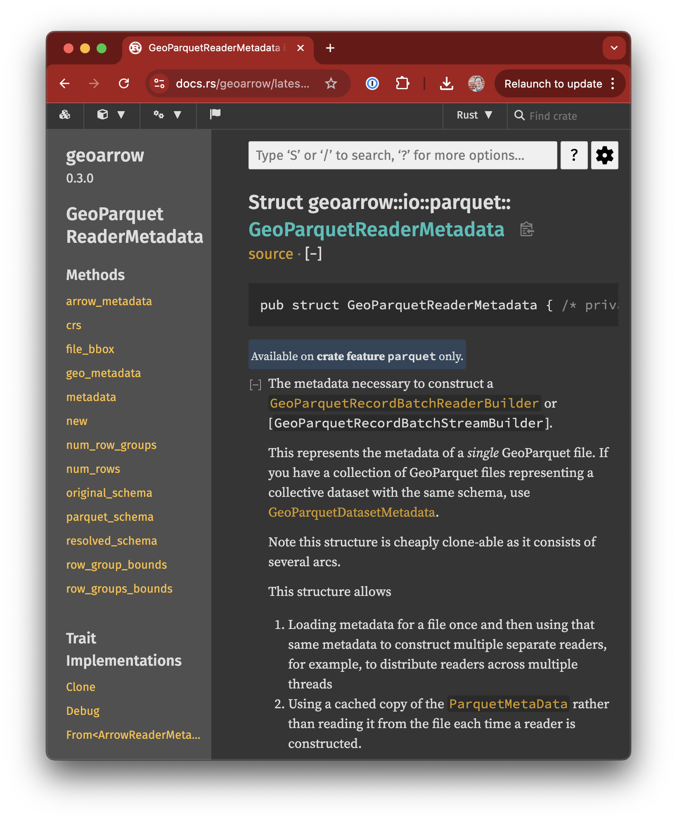
Python and the browser are accessible to the broadest audience
Automatic documentation
Put markdown in /// blocks before code
Documentation automatically rendered and hosted on docs.rs website every release

Slide 21
Rust for Python
Notes:
We'll come back to more features about Rust, but first, I want to go into the decision process that led me to decide to learn Rust.
That’s just about all I knew about Rust when I decided it was worth trying out.

Slide 22
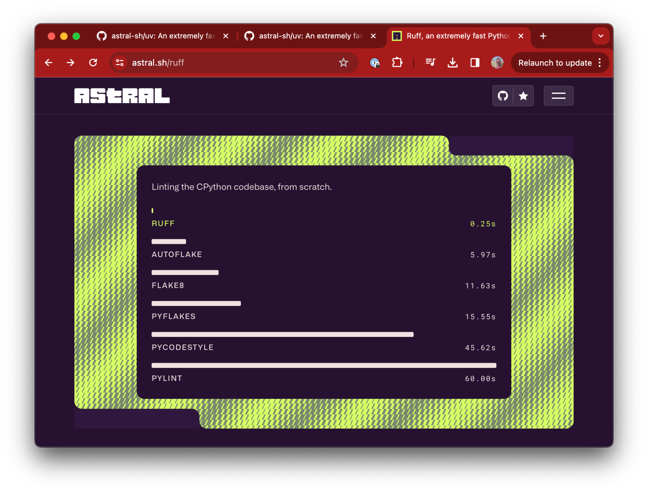

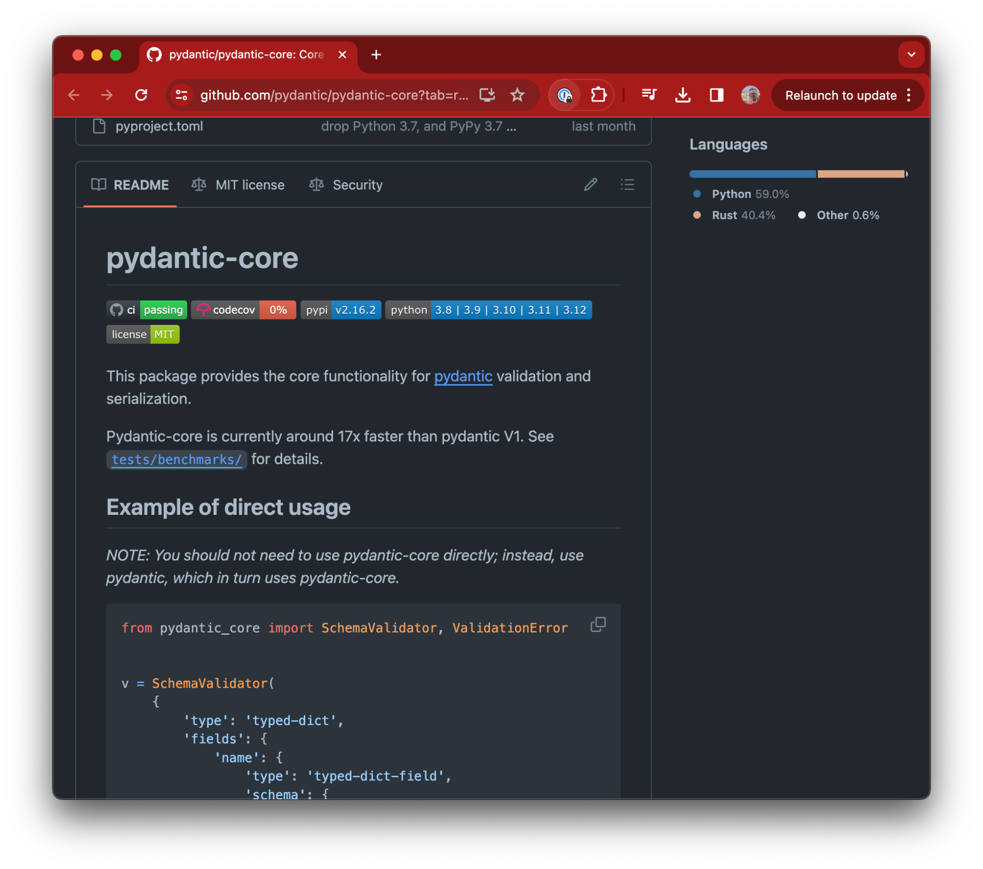

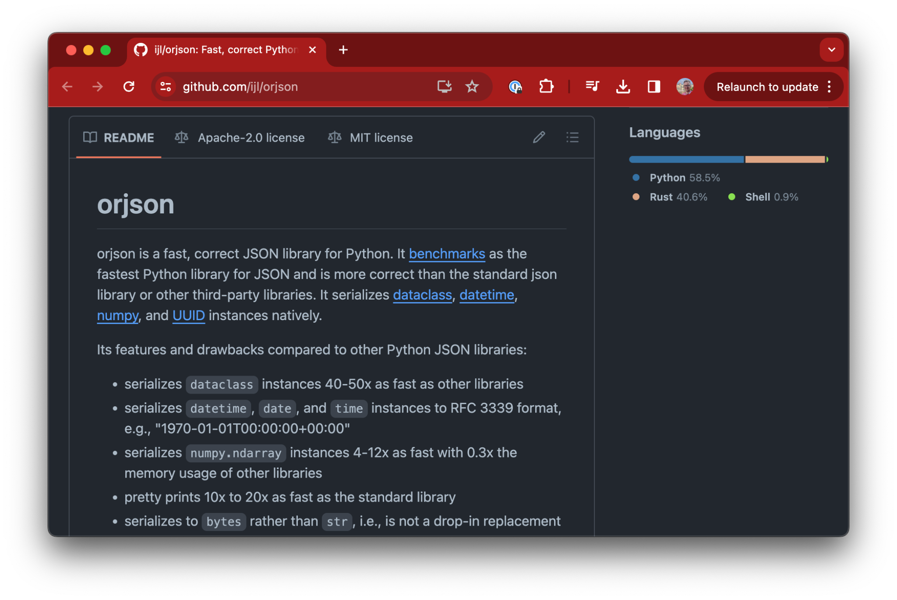
Python and the browser are accessible to the broadest audience
Big growth in Rust-backed Python libraries

Slide 23
Python and the browser are accessible to the broadest audience
Reuse existing Rust code
Weigh pros/cons of porting vs binding
Porting: rewriting in Python
Binding: compiling Rust to Python library
Binding often less work, less maintenance
Fewer hurdles than in JavaScript
Python not sandboxed

Slide 24
Python and the browser are accessible to the broadest audience
pyo3 glue library
Manages interop between Rust and Python
Supports any Rust libraries, even with C dependencies
Handles conversions from Python types into Rust types and vice versa
Easy multithreading (Impossible to have data races in Rust)

Slide 25
Python and the browser are accessible to the broadest audience
Simple to build
maturin build tool does everything for you
Just run maturin build; that’s it.
All Rust dependencies compile statically into Python wheel

Slide 26
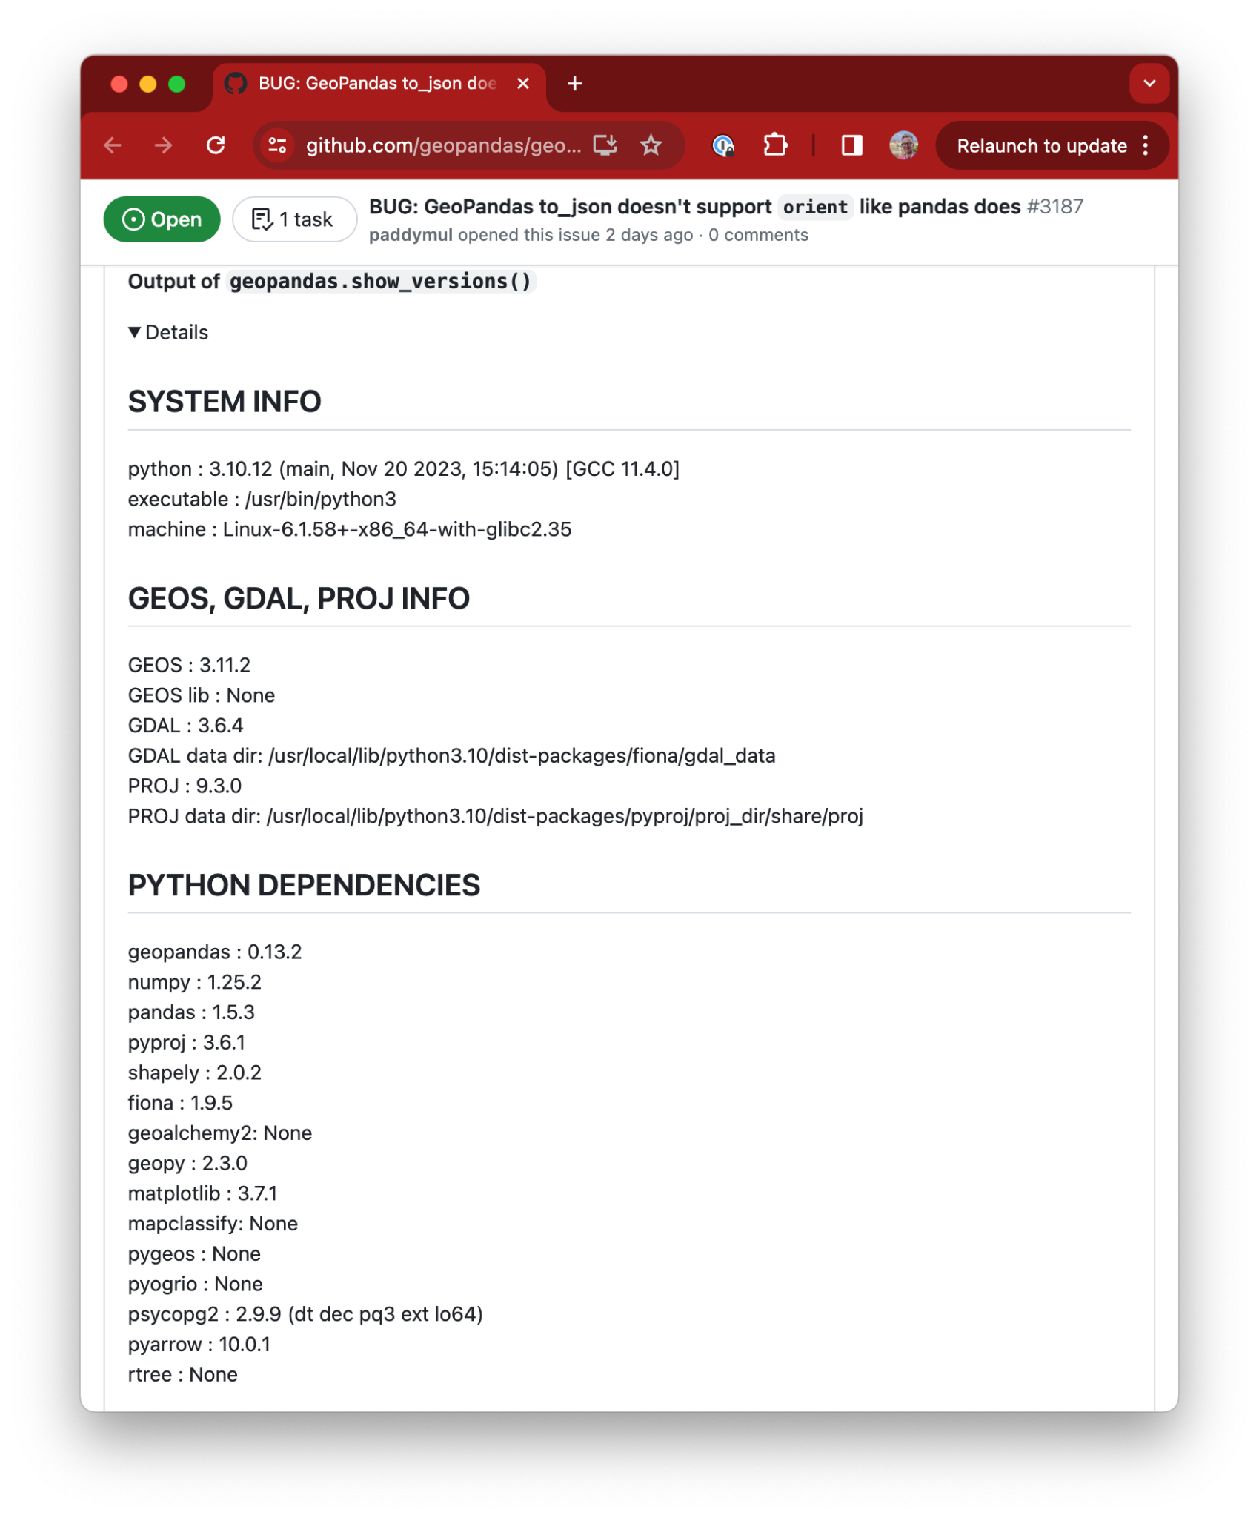
Reusing existing optimized libraries
Simpler distribution
Statically link Rust dependencies
Dependencies are in control of the developer not the user
Self-contained Python installs without (necessarily) needing GEOS, GDAL, etc
Support for less-used environments
Python in the browser
Alpine linux

Slide 27
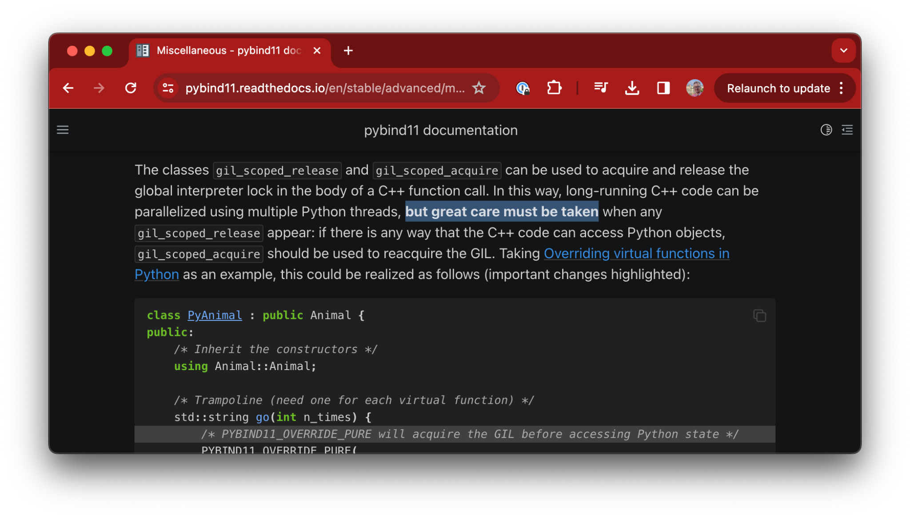
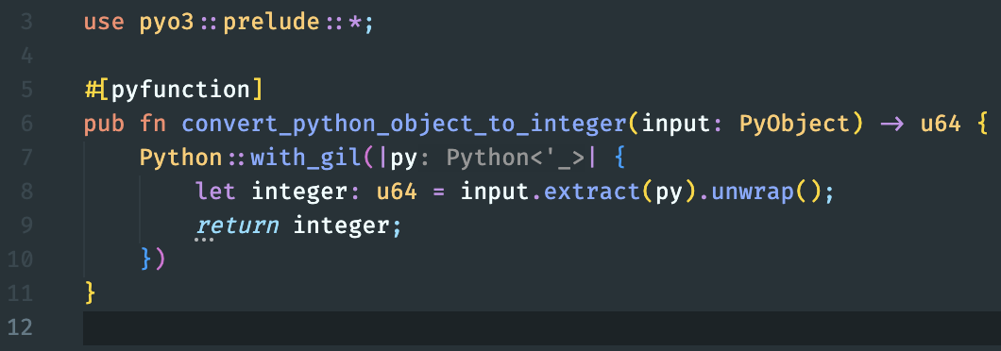
Python and the browser are accessible to the broadest audience
Prevents shooting yourself in the foot
Pybind11 (python-C++ glue): be careful, good luck!
When calling Python functions you must comply with the Global Interpreter Lock (GIL)
Rust PyO3 will not compile if your code breaks this rule
Can’t accidentally shoot yourself in the foot
Errors at compile time before you run the code instead of silent errors later
Rust: must have GIL to call Python function

Slide 28
Reusing existing optimized libraries
Downsides of Rust for Python
Two-language problem
Most users don’t know how to contribute
Serialization overhead of data between Rust and Python
Rust code needs to access Python data
Buffer protocol & (Geo)Arrow help solve this problem

Slide 29
Rust for JavaScript (WebAssembly)
Notes:
We'll come back to more features about Rust, but first, I want to go into the decision process that led me to decide to learn Rust.
That’s just about all I knew about Rust when I decided it was worth trying out.

Slide 30
Python and the browser are accessible to the broadest audience
Reuse existing Rust code
Weigh pros/cons of porting vs binding
Porting: rewriting in JavaScript
Binding: compiling Rust to WebAssembly with mixed application
Binding often less work, less maintenance

Slide 31
Python and the browser are accessible to the broadest audience
Performance
WebAssembly can be but is not always faster than JavaScript
Best candidates are computationally-bound operations hard to implement in pure JS
Network requests, DOM operations won’t be faster than JS

Slide 32
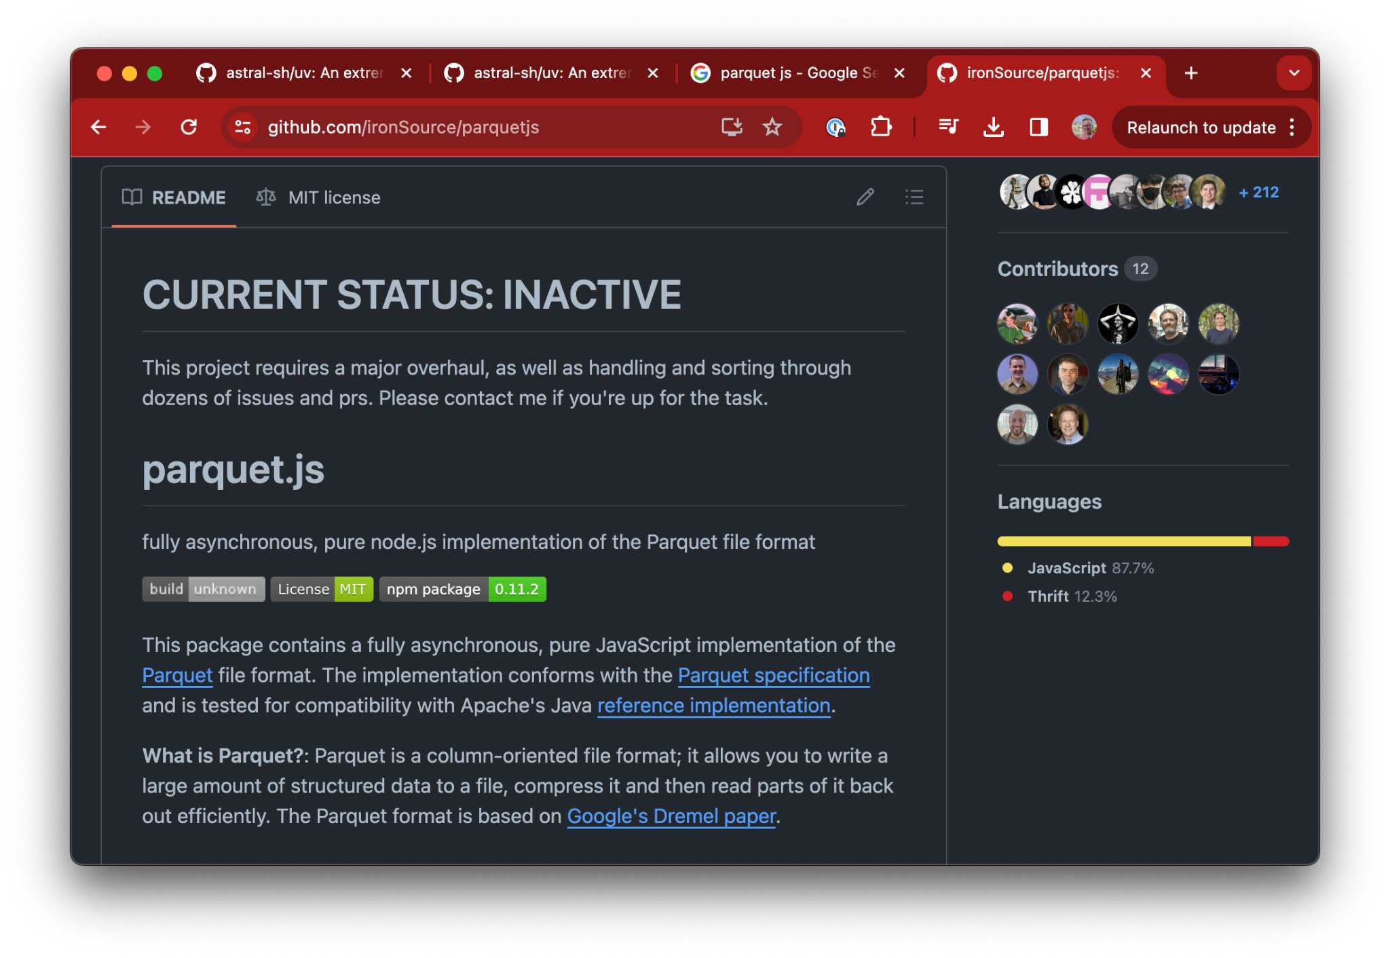
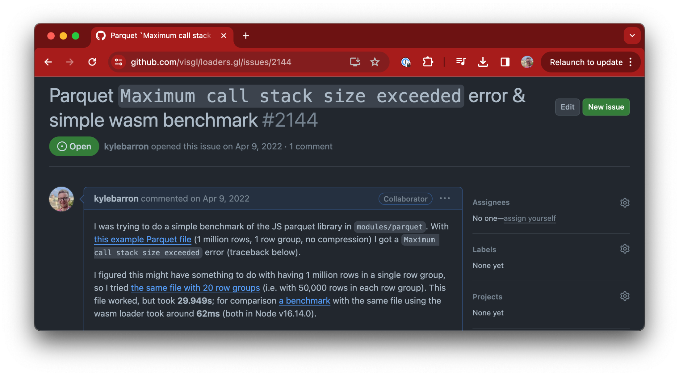
Reusing existing optimized libraries
Parquet case study
The Parquet file format is very complex. Several pure-JS Parquet attempts failed
I used Parquet in Wasm as my “learn Rust” project
visgl/loaders.gl repo forked and updated JS version
Benchmark: 62ms vs 29.9s, 483x faster
A couple weeks of my free time vs years of on and off development
An optimized pure-JS version would likely have similar performance, but we get amazing perf for free because the Rust implementation was already optimized
Notes:
It's not that the loaders.gl version is bad, it's that it's really, really hard and a big engineering investment to implement reading these files. There are a bunch of people writing databases in Rust, and so I can take advantage of all of their investment and get great performance for free.

Slide 33
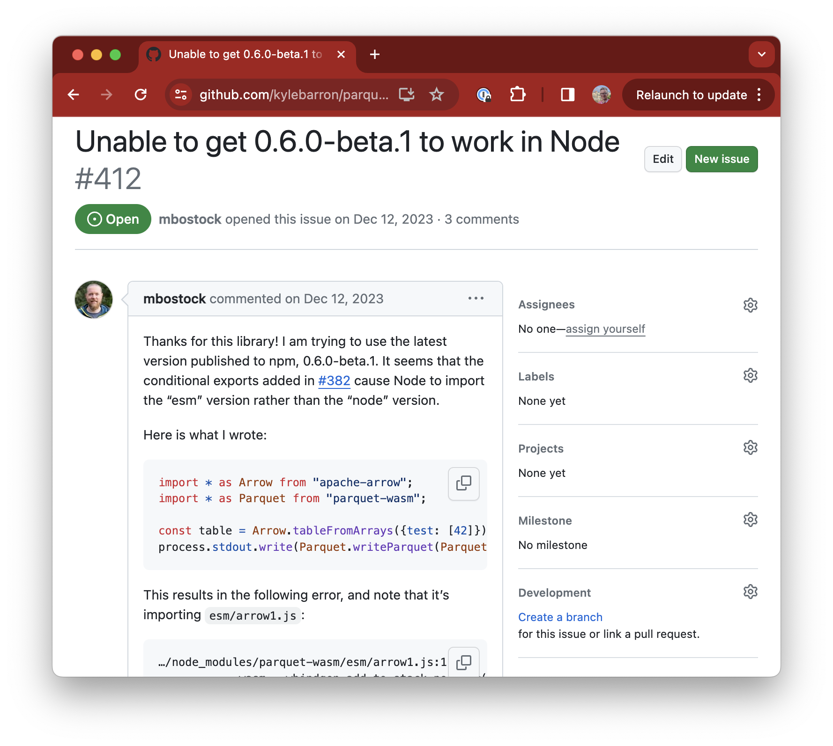
Reusing existing optimized libraries
Downsides of WebAssembly
Harder to bundle in applications
No longer just JavaScript, need extra WebAssembly binary file (.wasm)
Copy data across JavaScript-Wasm boundary
Wasm is sandboxed and can’t access JS objects directly
Arrow can help solve this
Manual memory management
Any time you want to store “state” in Wasm, you’ll have to manually free it
Large bundle sizes, no standard library

Slide 34
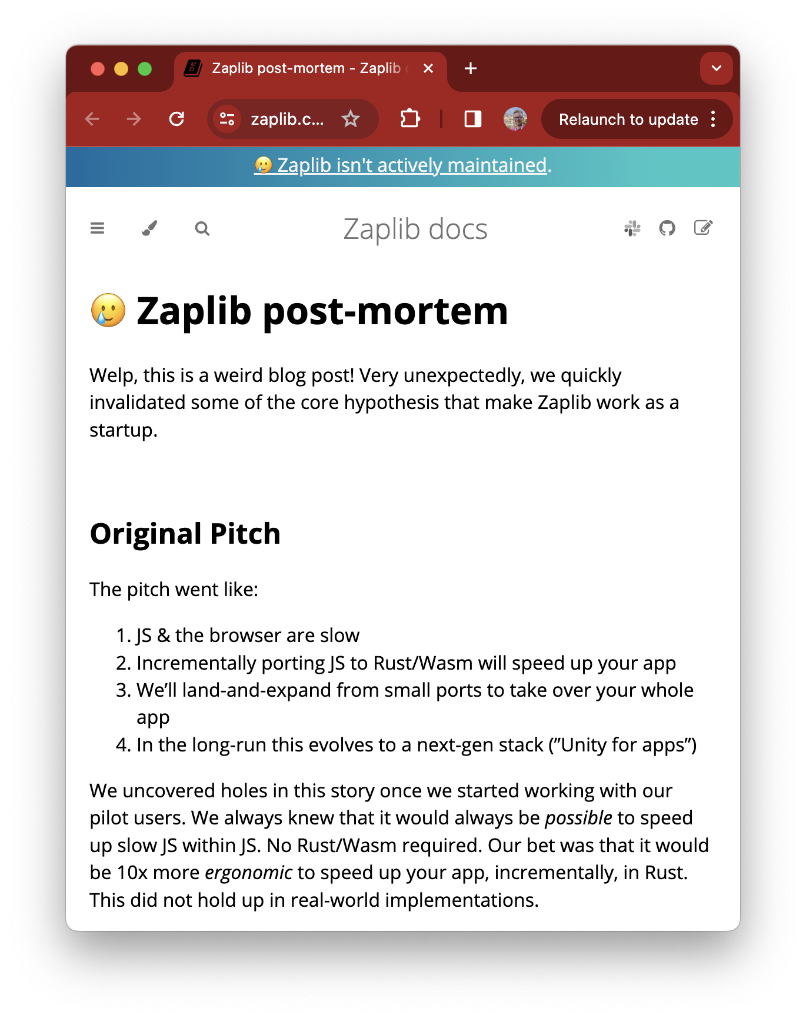
Reusing existing optimized libraries
Downsides of WebAssembly
Not always faster than JS!
Best candidates are computationally-bound operations
Network requests, DOM operations won’t be faster than JS
https://zaplib.com/docs/blog_post_mortem.html

Slide 35
Python and the browser are accessible to the broadest audience
wasm-bindgen glue library
Manages interop between Rust and JavaScript
Any* pure-Rust libraries will just work in Wasm
Networking libraries need to use browser APIs
Libraries with C dependencies (e.g. GEOS) may not work by default
Further progress on compiling Rust to Wasm via emscripten which allows C dependencies

Slide 36
Rust for R
Notes:
We'll come back to more features about Rust, but first, I want to go into the decision process that led me to decide to learn Rust.
That’s just about all I knew about Rust when I decided it was worth trying out.

Slide 37

rextendr
Glue library for Rust < – > R interop

Slide 38
Rust for Geospatial
Notes:
We'll come back to more features about Rust, but first, I want to go into the decision process that led me to decide to learn Rust.
That’s just about all I knew about Rust when I decided it was worth trying out.

Slide 39
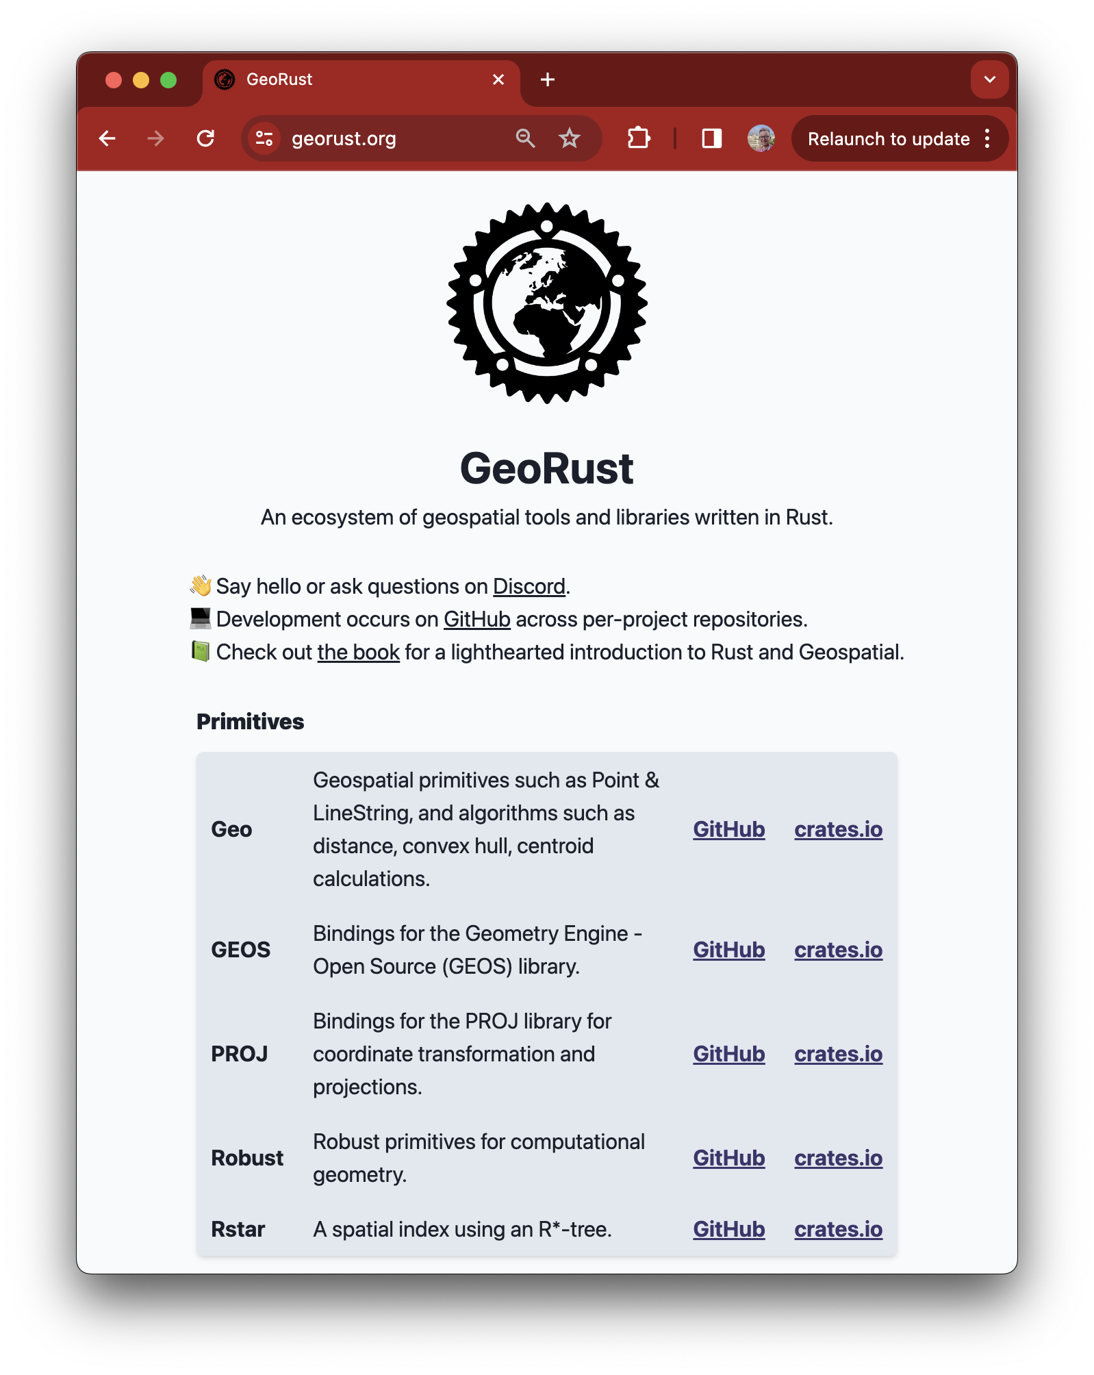
Reusing existing optimized libraries
GeoRust
Pure rust:
Core spatial operations (think Shapely/GEOS) in 2D
Spatial indexes
File format readers/writers
Openly-licensed
Bindings to GEOS/PROJ/GDAL
Generally higher level API than C, same performance
Engaged community
Con: less work so far on raster side

Slide 40
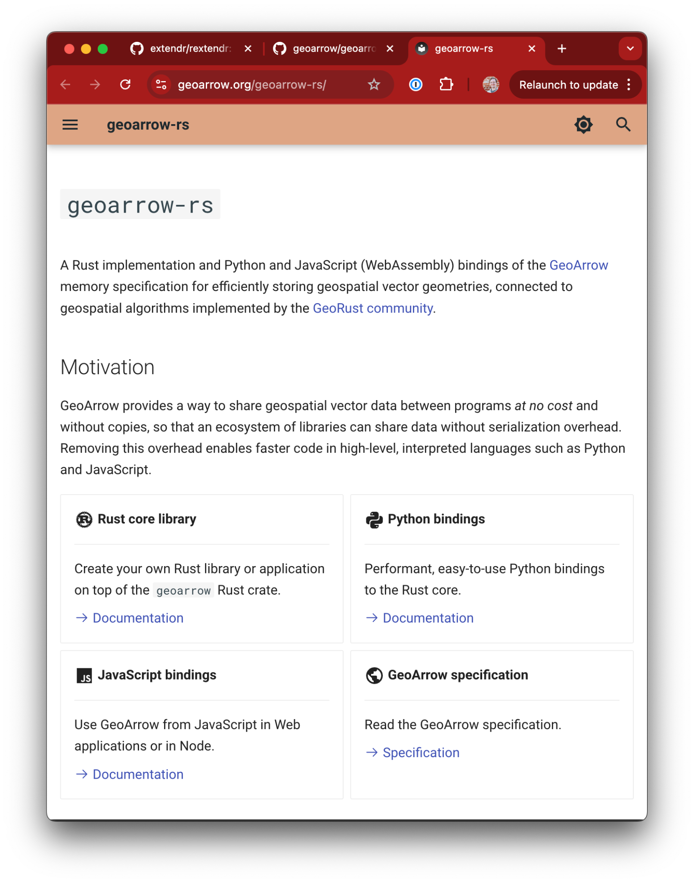
Reusing existing optimized libraries
geoarrow-rust
Data representation
XY, XYZ
Mixed types and GeometryCollection
Arrow for attributes
Wrappers of geo and GEOS algorithms
Pure-rust file format readers and writers: GeoJSON, FlatGeobuf, GeoParquet, WKB, WKT, CSV, Shapefile (soon)
Bindings to Python and JS
“geo traits” for zero-copy geo rust interop across crates (geo, GEOS, WKB)

Slide 41
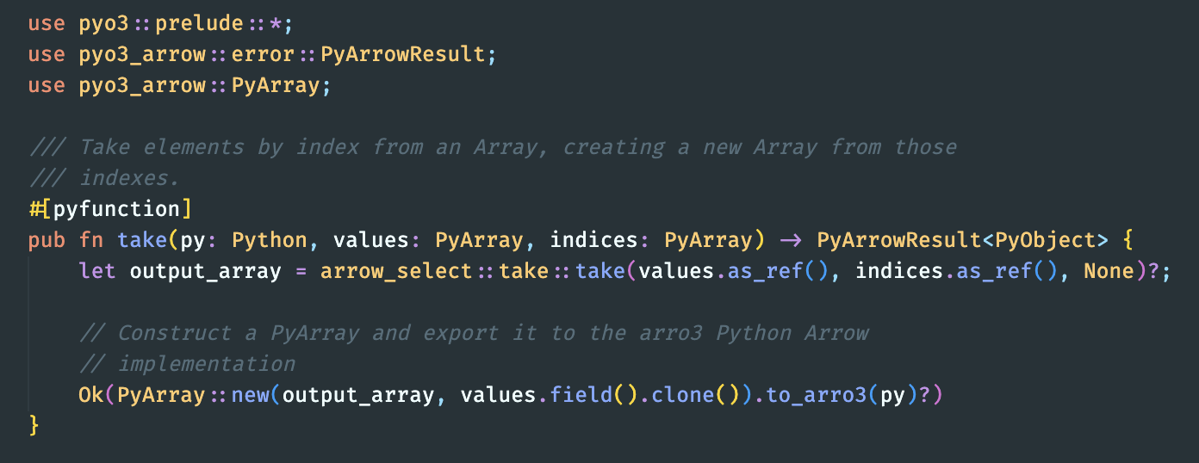
Make it easy for other developers
pyo3-arrow: Simple Python-Rust Arrow Interop
Two lines of code to wrap existing Rust function and export to Python
Manages zero-copy FFI for you

Slide 42
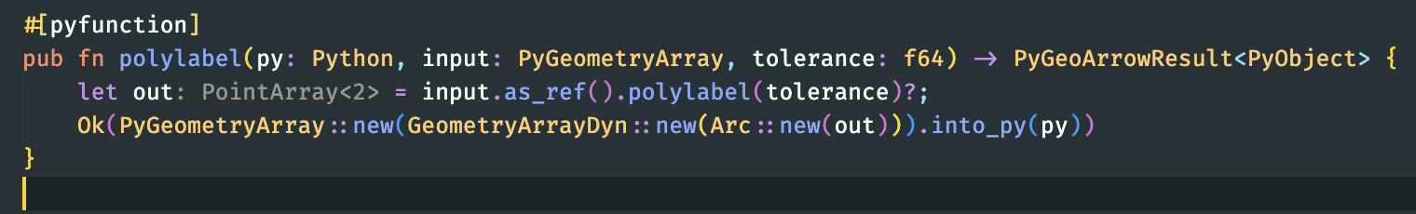
Make it easy for other developers
pyo3-geoarrow: Simple Python-Rust GeoArrow Interop
Two lines of code to wrap existing Rust function and export to Python
Manages zero-copy GeoArrow FFI for you

Slide 43
Use cases
Notes:
We'll come back to more features about Rust, but first, I want to go into the decision process that led me to decide to learn Rust.
That’s just about all I knew about Rust when I decided it was worth trying out.

Slide 44

Reusing existing optimized libraries
Inside Lonboard
Parquet files sent to the browser for smaller downloads
Uses Rust from JavaScript to parse Parquet files

Slide 45

Reusing existing optimized libraries
Overture data explorer
Fetches current viewport from 2.4-billion row dataset, straight from client to GeoParquet in the cloud
Uses geoarrow-rust in Wasm
(PMTiles used for visualization)

Slide 46

geoarrow-rust
Vectorized geospatial operations
GEOS operates only on scalars
Shapely in Python operates on arrays, lots of Python-specific code
GeoArrow-Rust:
Implement operations on arrays once
Trivial bindings to Python, JS, R, etc
Connect to other Rust libraries like Polars, DataFusion
Early benchmarks:
2-5x faster than GDAL (pyogrio+arrow) at reading/writing (though doesn’t support arbitrary SQL)
“Explode” 450x faster than GeoPandas (special case)

Slide 47
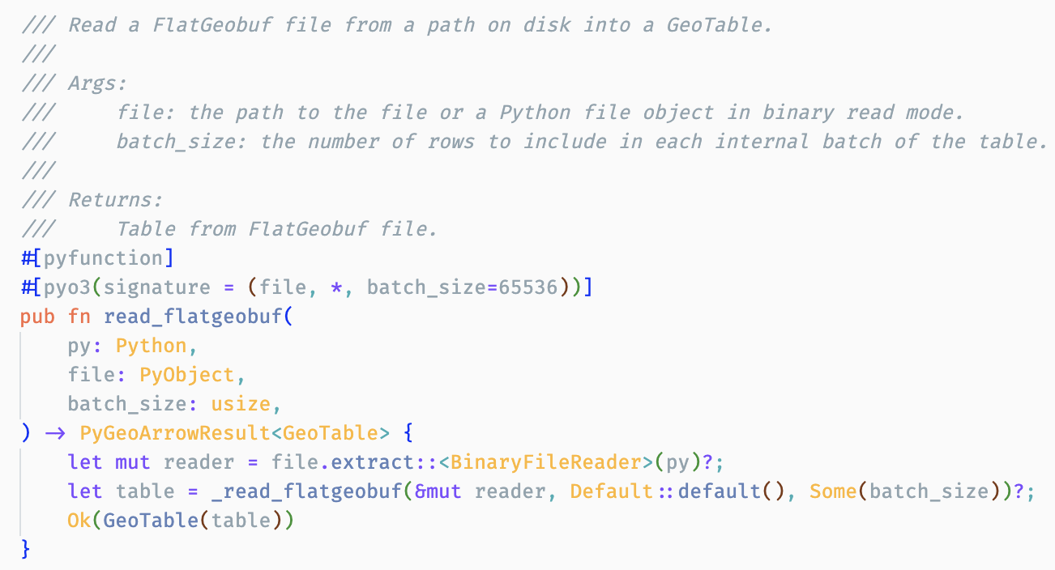
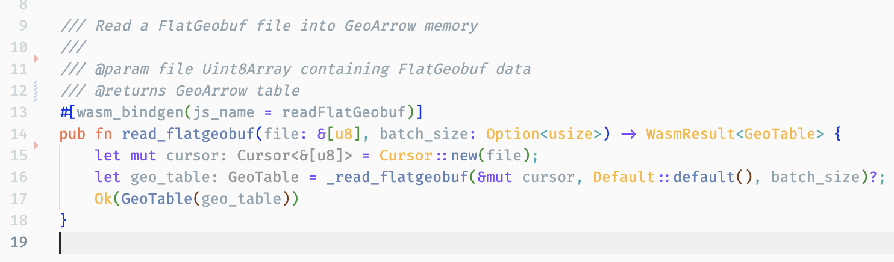
geoarrow-rust
Minimal bindings for multiple languages
Write one core implementation, simple binding to many languages
Python read_flatgeobuf implementation
JavaScript read_flatgeobuf implementation

Slide 48
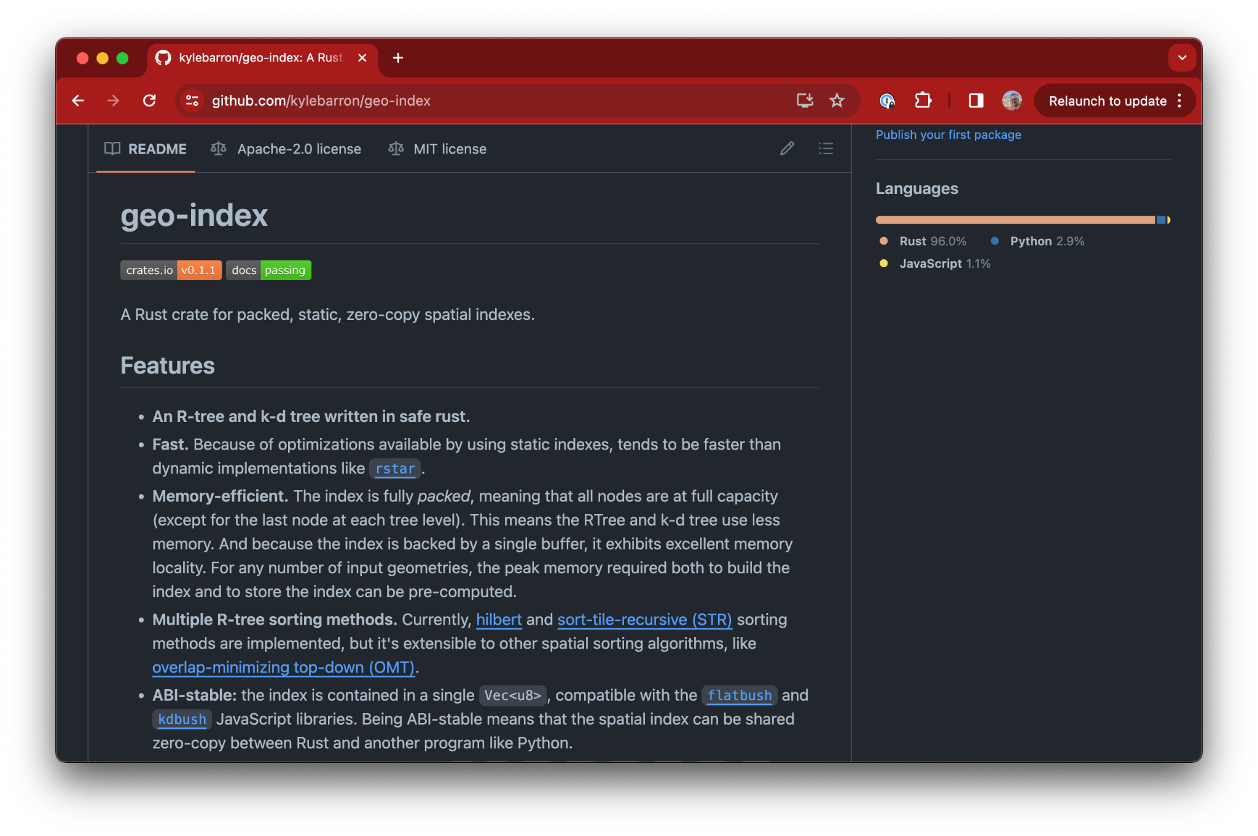
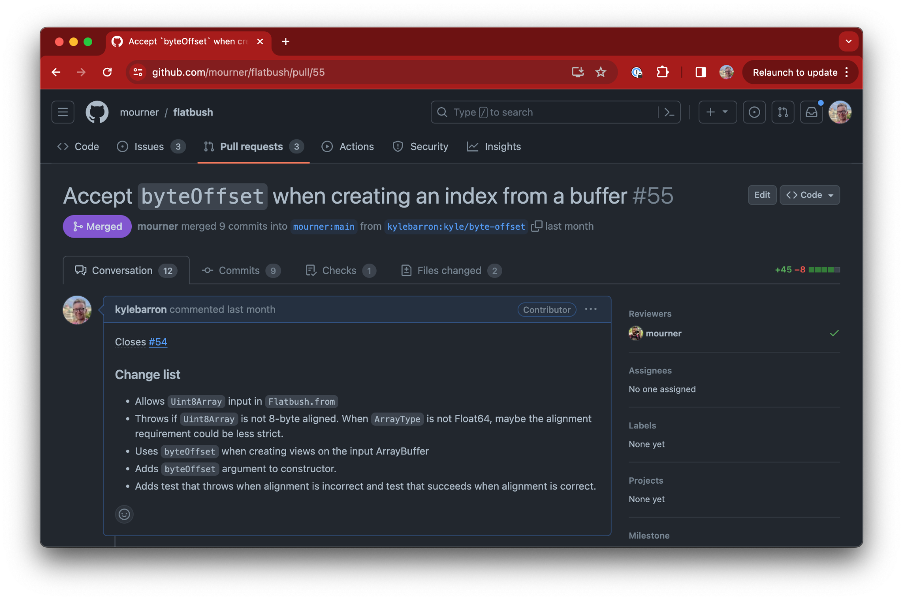
Reusing existing optimized libraries
Zero-copy spatial indexes
Port of flatbush JS library
Among the fastest spatial index implementation in Rust
2x faster to create than most popular (dynamic) library
Share spatial index between Rust and @mourner’s flatbush for free
Fast spatial joins in the browser

Slide 49
The high level
References
“Considering Rust” highly recommended 1 hour, no code, outlines pros/cons of Rust. https://www.youtube.com/watch?v=DnT-LUQgc7s
The Rust Programming Language Book (Free online https://doc.rust-lang.org/book/ )
Rust for Rustaceans Book (intermediate book after above)
PyO3 user guide https://pyo3.rs
Rust WebAssembly Guide https://rustwasm.github.io/book/
Ask me!
Rust's power is as a complement, not a replacement, to higher-level languages

